Slide 1
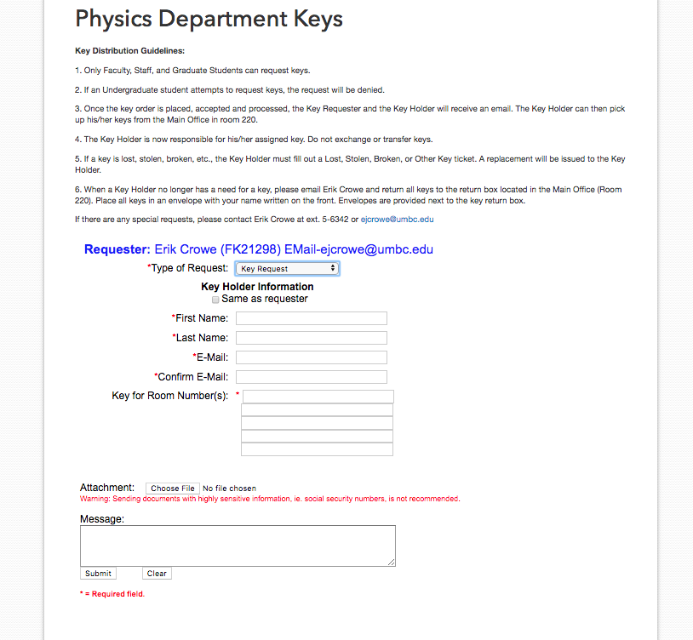
Can the Key Return option be removed from the Key Requester’s view, but still be available for me to use on the back end of the form for organizational purposes?
Can you add a note that says, “Enter the specific room # in each box. Each completed field creates a individual key request ticket”.
And add numbers 1-5 in front of each box to indicate the requester to complete these fields. Most Requesters put the room numbers in the message field.

